Slide 1
The Automatic Motive Coder:
Towards a Tool for the Efficient Assessment of Implicit Motives Max Brede Felix Schönbrodt Birk Hagemeyer Veronika Lerche

Slide 2
Background

Slide 3
Implicit Motives
Implicit motives are motivational dispositions […] that operate outside of a person’s conscious awareness, and that promote attainment of certain classes of incentives and avoidance of certain classes of disincentives (O. Schultheiss & Köllner, 2021).
Implicit Motives are typically measured using (semi-) projective measures, i.e., the Picture Story Exercises.
O. C. Schultheiss et al. (2009) showed that correlations between Implicit Motives and Explicit Motives (i.e. motives measured with questionnaires) were “small and mostly nonsignificant”.

Slide 4

Measurement of Implicit Motives - PSE
Two months ago, 40-year-old Frank received a good offer from New York. In discussion with his family, he accepted the offer and is now sitting in his office in New York. Like every morning, he reads the latest news in the daily newspaper. The picture of his family has a place of honor on his desk and is always at hand so that he can take a closer look at it. He misses his family as he can’t fly back home until Christmas. In the 4 weeks so far, the time difference has been particularly difficult for him, as work and the different times have made it difficult to make contact. He is already looking forward to seeing his wife and children again.
Example image used in the PSE; Source: Ramsay (2014)

Slide 5
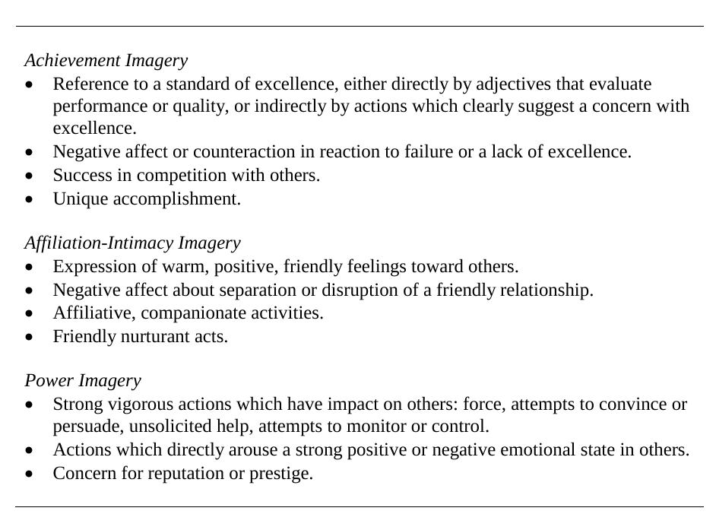
Winter Coding-Manual
Source: Winter (1991b)

Slide 6
Measurement of Implicit Motives - PSE
Two months ago, 40-year-old Frank received a good offer from New York. In discussion with his family, he accepted the offer and is now sitting in his office in New York. Like every morning, he reads the latest news in the daily newspaper. The picture of his family has a place of honor on his desk and is always at hand so that he can take a closer look at it. He misses his family as he can’t fly back home until Christmas. In the 4 weeks so far, the time difference has been particularly difficult for him, as work and the different times have made it difficult to make contact. He is already looking forward to seeing his wife and children again.
Example image used in the PSE; Source: Ramsay (2014)

Slide 7
The Automatic Motive Coder 🤖

Slide 8
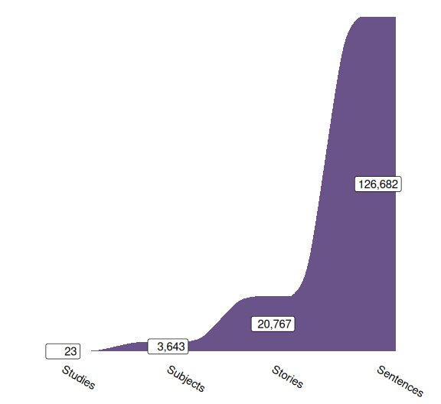
Dataset
Schönbrodt et al. (2021) published a database of
126,682 sentences from
20,767 stories written by
3,643 participants in
23 studies
Each coded by experts based on the Winter Manual (Winter, 1991a).

Slide 9

Automatic Motive Coder 🤖
Bag Of Words (BOW)
BOW-representation of sentences.

Slide 10
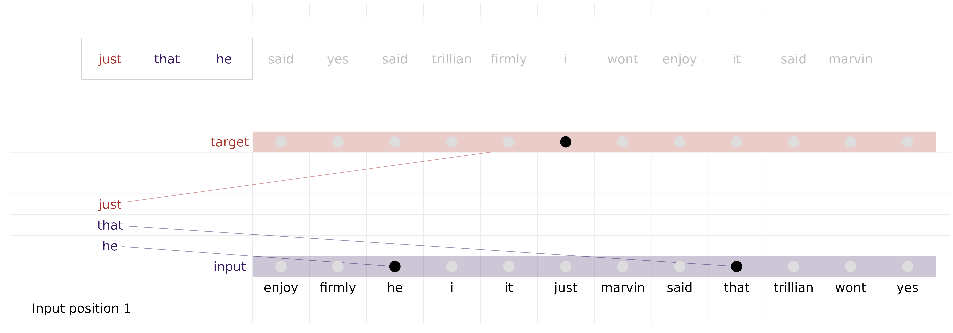
Automatic Motive Coder 🤖
Embedding-example: Continuous BOW (CBOW)
CBOW-representation of corpus.

Slide 11
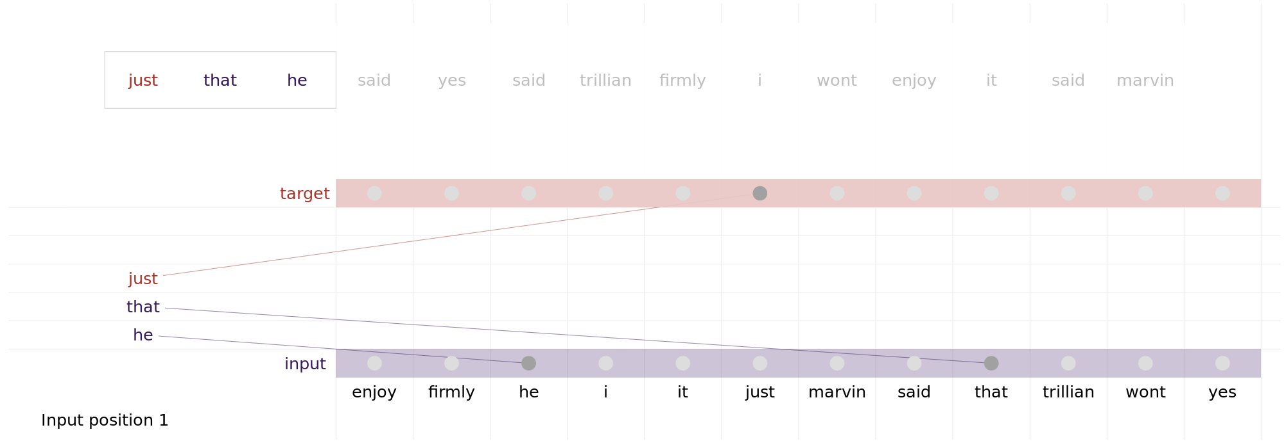
Automatic Motive Coder 🤖
Embedding-example: Continuous BOW (CBOW)
CBOW-representation of corpus.

Slide 12
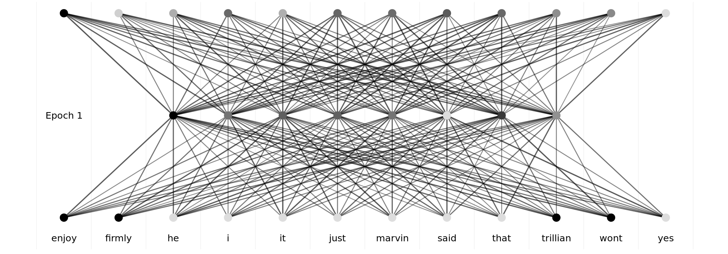
Automatic Motive Coder 🤖
fasttext¹
Model using CBOW-Method to predict missing word.

Slide 13
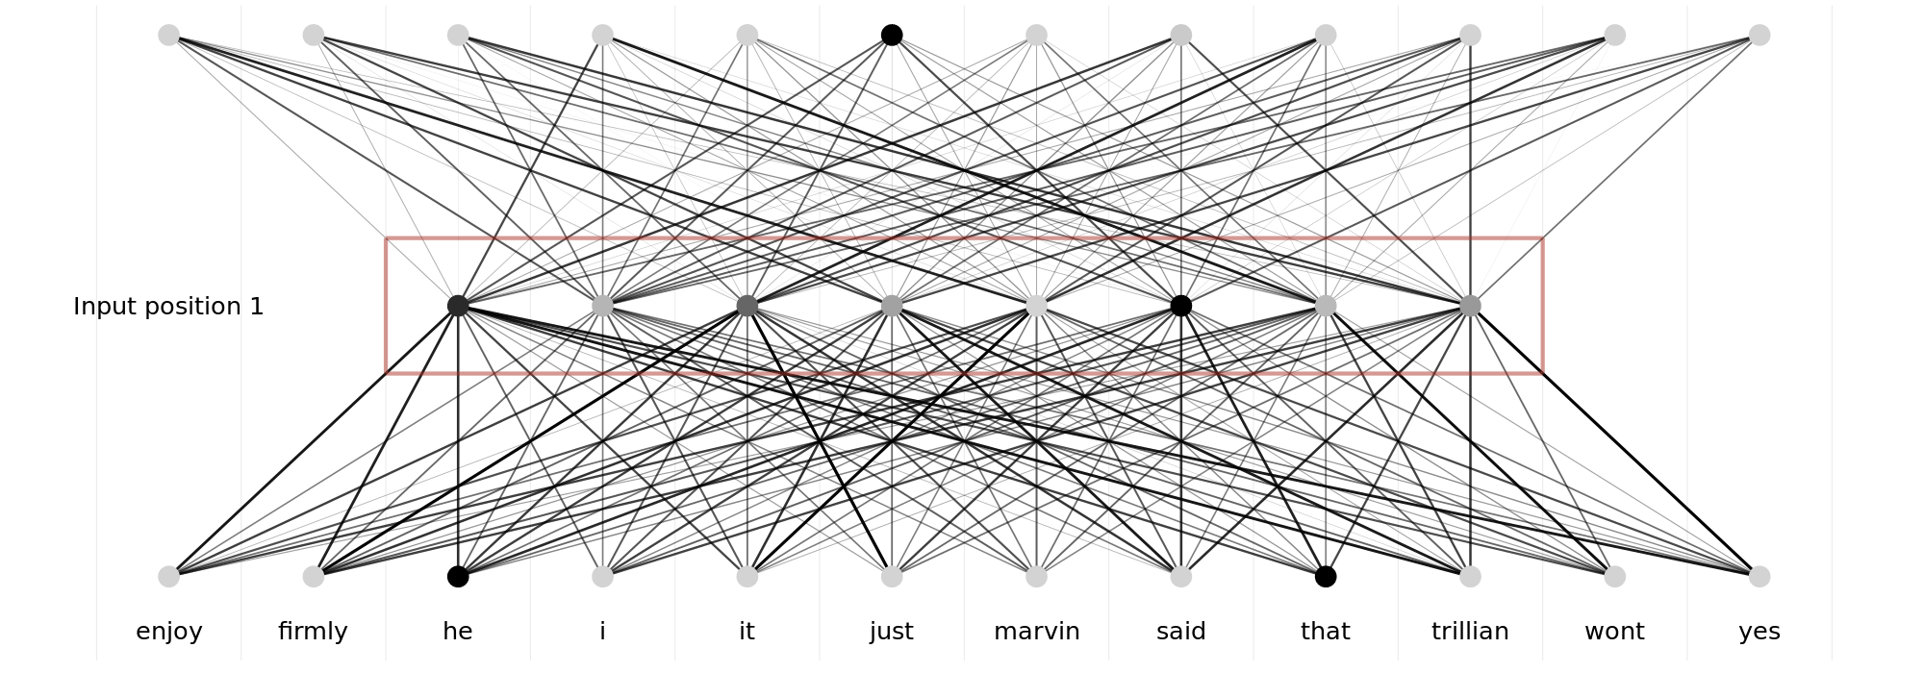
Automatic Motive Coder 🤖
(L)LM -Embeddings
Model using CBOW-Method to predict missing word.

Slide 14
Tested 🤖-Architectures
“Traditional” BOW/Embedding-Classifier-Stack
LoRA-Finetuning of small LM (Hu et al., 2021)
AMC-Illustration, Source: DALL-E

Slide 15
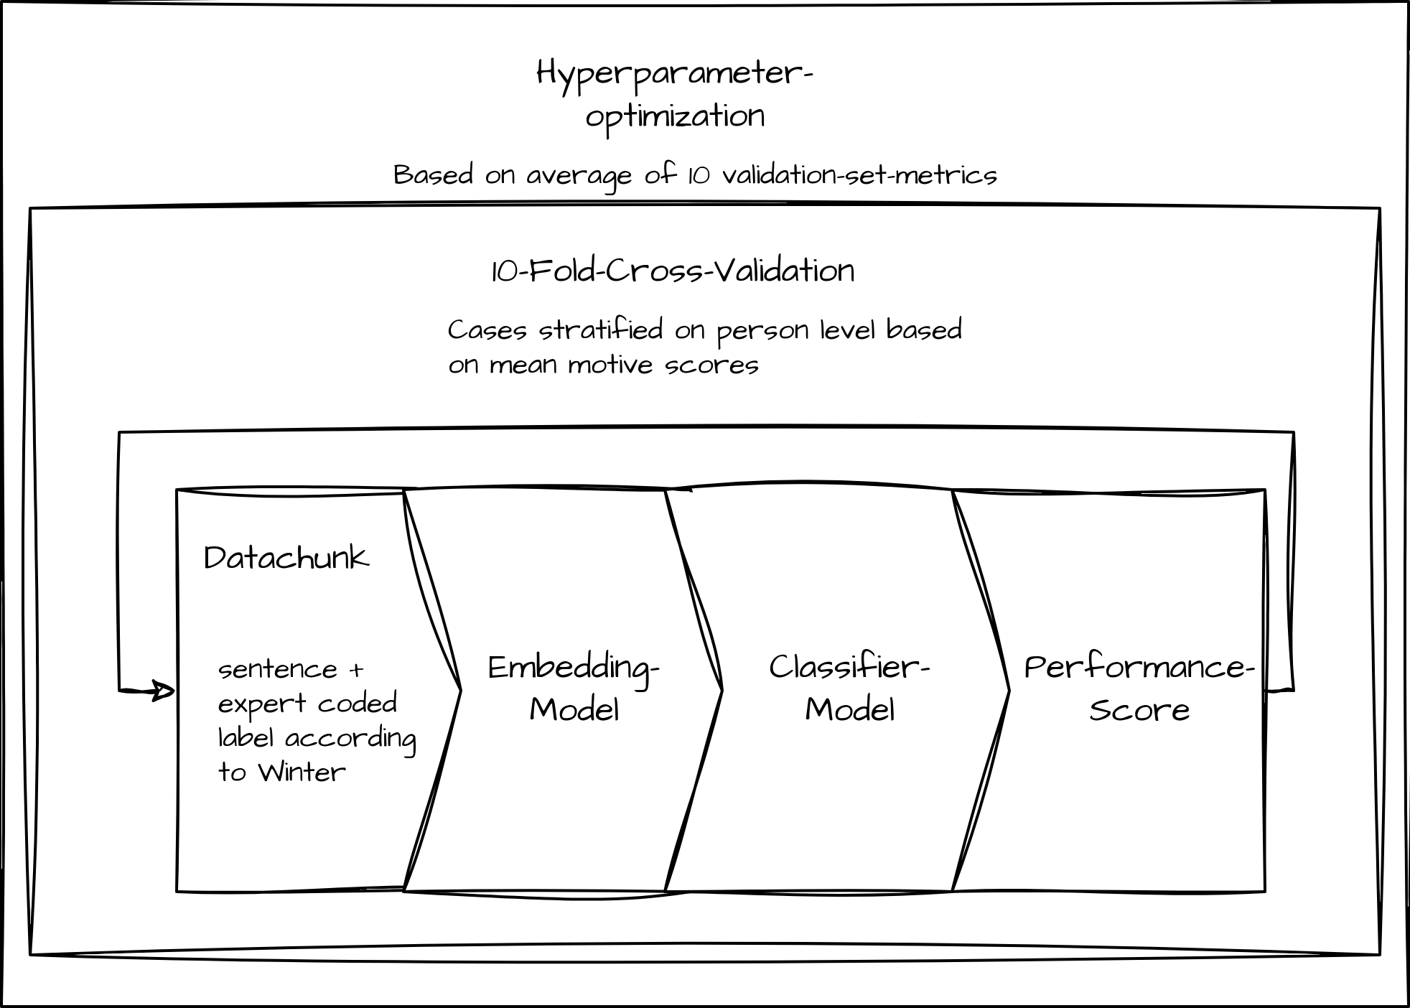
Embedding - Classifier-Stack
Illustration of Classifier-Stack

Slide 16
LoRA
Finetuning of small LMs (Phi-3-mini-4k(Unsloth/Phi-3-mini-4k-instruct $⋅$ Hugging Face, n.d.)/gemma-2b(Google/Gemma-2b $⋅$ Hugging Face, 2024)) (partly) based on the following prompt:
- **Achievement**: Label as 'ach' if the sentence suggests goals related to personal success, overcoming challenges, or mastering skills. - **Affiliation**: Label as 'aff' if the sentence emphasizes relationships, emotional connections, or social belonging. - **Power**: Label as 'pow' if the sentence implies influencing, controlling, or impacting others, or showcases a desire for authority or prestige. - **None**: Use 'null' if the sentence does not clearly align with the above categories or lacks sufficient context to determine a specific motive.

Slide 17
Example
Comparison between model results and expert coding
Text | Expert | Model¹ | Model | Model | Model
 | Coding | Achievement | Affiliation | None | Power
Two months ago, 40-year-old Frank received a good offer from New York. | None | 0.07 | 0.06 | 0.86 | 0.02
In discussion with his family, he accepted the offer and is now sitting in his office in New York. | None | 0.09 | 0.12 | 0.75 | 0.04
Like every morning, he reads the latest news in the daily newspaper. | None | 0.02 | 0.03 | 0.93 | 0.02
The picture of his family has a place of honor on his desk and is always at hand so that he can take a closer look at it. | Affiliation | 0.23 | 0.60 | 0.15 | 0.02
He misses his family as he can't fly back home until Christmas. | Affiliation | 0.05 | 0.80 | 0.14 | 0.01
In the 4 weeks so far, the time difference has been particularly difficult for him, as work and the different times have made it difficult to make contact. | Affiliation | 0.02 | 0.88 | 0.10 | 0.01
He is already looking forward to seeing his wife and children again. | Affiliation | 0.10 | 0.66 | 0.23 | 0.01
¹Mixtral-8x7B-Instruct-v0.1 with MLP-Classifier

Slide 18
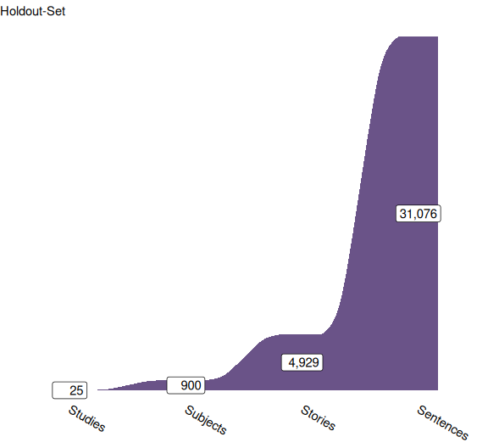
Validation Metrics
Procedure as described in Schönbrodt et al. (2021):
Summation of Motive score (1/0-coded) and word-count per subject
Robust regression of motive score on word-count / 1,000
Extraction of residuals as corrected motive score
Pearson-Correlation of expert coded motive scores and model coded scores

Slide 19
Results
German Texts
Translated to English
Motive | Best BOW-Stack | Best Embedding-Stack¹ | LoRA-Model² | Nilsson et al. 2024
Achievement | 0.66 | 0.66 | 0.67
Affiliation | 0.79 | 0.78 | 0.77
Power | 0.72 | 0.68 | 0.69
None |  | 0.90 | 0.92
Mean |  | 0.71 | 0.70
¹Mixtral-8x7B-Instruct-v0.1 with MLP-Classifier
²gemma-2b
Motive | Best BOW-Stack | Best Embedding-Stack¹ | LoRA-Model² | Nilsson et al. 2024
Achievement |  | 0.58 | 0.66 | 0.64
Affiliation |  | 0.71 | 0.75 | 0.73
Power |  | 0.57 | 0.66 | 0.62
None |  | 0.88 | 0.92 | 0.93
Mean |  | 0.62 | 0.69 | 0.66
¹Mixtral-8x7B-Instruct-v0.1 with MLP-Classifier
²gemma-2b

Slide 20
Outlook
Further optimization
Test of the general pipeline on other motive measures
Publication of python-code / R-Wrapper for convenient usage
Implementation of “SetFit” (Tunstall et al., 2022)

Slide 21

Thank You!
Contact me:
Repo with this presentation:

Slide 22
References
Google/gemma-2b $⋅$ Hugging Face. (2024). https://huggingface.co/google/gemma-2b.
Hu, E. J., Shen, Y., Wallis, P., Allen-Zhu, Z., Li, Y., Wang, S., Wang, L., & Chen, W. (2021). LoRA: Low-Rank Adaptation of Large Language Models (No. arXiv:2106.09685). arXiv. https://doi.org/10.48550/arXiv.2106.09685
Ramsay, J. E. (2014). Refining the picture story exercise: Towards a better understanding of hope, fear, and the achievement motive [PhD thesis].
Schönbrodt, F. D., Hagemeyer, B., Brandstätter, V., Czikmantori, T., Gröpel, P., Hennecke, M., Israel, L. S. F., Janson, K. T., Kemper, N., Köllner, M. G., Kopp, P. M., Mojzisch, A., Müller-Hotop, R., Prüfer, J., Quirin, M., Scheidemann, B., Schiestel, L., Schulz-Hardt, S., Sust, L. N. N., … Schultheiss, O. C. (2021). Measuring Implicit Motives with the Picture Story Exercise (PSE): Databases of Expert-Coded German Stories, Pictures, and Updated Picture Norms. Journal of Personality Assessment, 103(3), 392–405. https://doi.org/10.1080/00223891.2020.1726936
Schultheiss, O. C., Yankova, D., Dirlikov, B., & Schad, D. J. (2009). Are Implicit and Explicit Motive Measures Statistically Independent? A Fair and Balanced Test Using the Picture Story Exercise and a Cue- and Response-Matched Questionnaire Measure. Journal of Personality Assessment, 91(1), 72–81. https://doi.org/10.1080/00223890802484456
Schultheiss, O., & Köllner, M. G. (2021). Implicit motives. In O. P. John & R. W. Robins (Eds.), Handbook of personality: Theory and research (Fourth edition). The Guilford Press.
Tunstall, L., Reimers, N., Jo, U. E. S., Bates, L., Korat, D., Wasserblat, M., & Pereg, O. (2022). Efficient Few-Shot Learning Without Prompts (No. arXiv:2209.11055). arXiv. https://arxiv.org/abs/2209.11055
Unsloth/Phi-3-mini-4k-instruct $⋅$ Hugging Face. (n.d.). https://huggingface.co/unsloth/Phi-3-mini-4k-instruct.
Winter, D. G. (1991a). Manual for scoring motive imagery in running text. Department of Psychology, University of Michigan.
Winter, D. G. (1991b). Measuring personality at a distance: Development of an integrated system for scoring motives in running text. In Perspectives in personality, Vol. 3: Part A: Self and emotion; Part B: Approaches to understanding lives (pp. 59–89). Jessica Kingsley Publishers.

Slide 23
Notes
1. kind of

